Slide 1



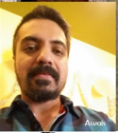
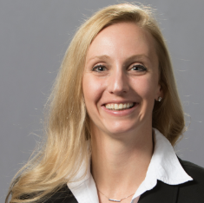

TEAM PROFILE
TEAM NAME: Pinky and the Brain
FOUNDER(S): Awais Sultan
VALUE DRIVER
+ PERSONALIZATION
TEAM MEMBERS: Awais Sultan, Erin Pizzi
PROBLEM: Personal budgeting is something individuals complete on a periodic basis, at best.
CUSTOMER(S): Any depository customer of US Bank.
HUNCH: Our team suspects that often times procrastination with budgeting leads to overspending, a lack of personal savings and investments and missed opportunities for tax deductions. Ignorance is not bliss.
IMPACT ESTIMATE: $__________
SPRING 2019

